Slide 1
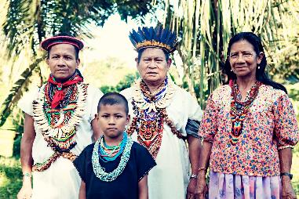
Siona /Kechwa Community San José de Wisuya

Slide 2
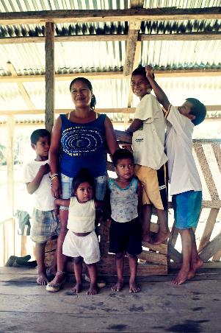
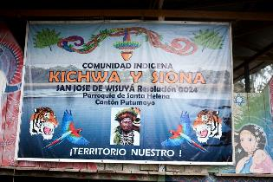
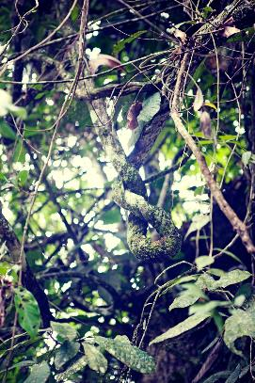
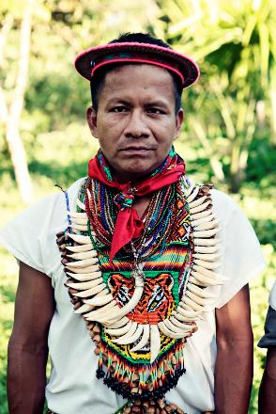
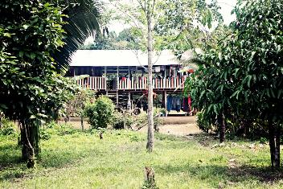
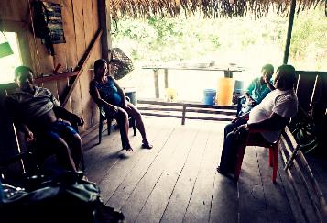

Slide 3
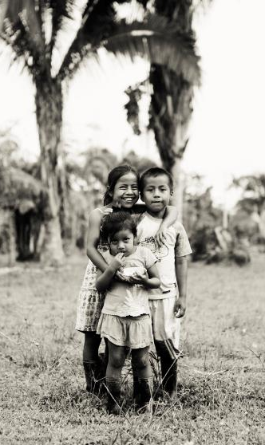
About the Community
The Siona / Kechwa Community of San José de Wisuya is located in the the north west of the Amazon Basin, It extends for 5 km along the Putumayo River. This river divide the frontier between the region of the Ecuatorian and Colombian Putumayo.
The region is classified as subtropical forest, characterized by high humidity and constant temperatures. The annual temperature is 25 degrees and the area is at an elevation of 260 meters above sea level.
The community is located about 50 km downstream from Puerto Asis (Colombia) and 250 km from Lago Agrio (Ecuador). Is home to about 150 people, of which 90 Siona, 80 kechwa and 30 settlers. The area of the community is approximately 1.200 hectares. 70% is native forest and the rest is divided among the inhabitants own crops.

Slide 4
History
From the beginning the missionaries and conquerors practiced strategies of domination and did a big effort to discover and destroy the ritual elements of Siona and kechwa knowledge and wisdom. The dances and ceremonies were banned. The indigenous resisted and prevailed shamans power, focusing on the domain and the management of the sacred and supernatural plant: Yajé.
San José de Wiuya constantly experienced processes of conquest, colonization and presence of strangers who one way or another have weakened the indigenous community. The population was decimated and their ancestral lands were altered and appropriate violently.
There are several reasons for it:
1. The extraction and exploitation of quinine. In the mid and late nineteenth century, navigation began in the Putumayo and Caqueta river, with the consequent enslavement, displacement and extermination of indigenous communities, which were gradually displacing the lower areas of the Rio Putumayo and Caquetá.
2. The rubber exploitation in the early twentieth century for marketing this product and all the bloody history of the Arana House..
3. The conflict in Colombia with Peru between 1930 and 1970, contributed to the destruction of indigenous cultures, as the relocation of entire populations from one region to another, for the benefit of one of the two countries, became nomadic communities in sedentary and their traditional authorities disappeared almost completely
4. Violence in the mid-twentieth century, results partisan struggles for power and politics led by Incora regarding colonization projects originated migration of peasants to the Amazon basin, expanding the agricultural frontier in this region and the subsequent displacement , extermination or acculturation of the indigenous communities causing the displacement from their ancestral lands.
5. The oil boom in Putumayo in the early sixties, also caused the displacement and extermination of indigenous communities.
6. The timber exploitation and expansion of Coca crops for illicit use began in the mid-70s.
7. The presence of different armed groups in Putumayo. The FARC that since 1984 controls the rural areas as a strategy against the expansion of the AUC and the state forces. The growth of both the FARC and the AUC is associated primarily with illicit coca circuits.

Slide 5
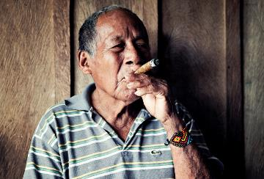
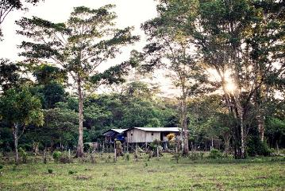
About Siona
The Siona, once a large group that ruled the upper Putumayo have been reduced to approximately 680 individuals. Most of them are located in the community of Buena Vista and the rest are located in the communities of Piñuña Blanco and San Jose de wisuya .
The Siona have had contact with Spanish since colonial times and at the beginning of the 20 century it was reported that most of the adults spoke a rudimentary form of Spanish. At the present time all Siona are bilingual.
The Siona language is a member of the Western branch of the Tukano Family , is spoken in almost all household situations. The elders use it at all times, for their expression and understanding is limited in Spanish.
Since the time of the conquest the power and social control lie on the political religious role of the Shamans (curacas). The legitimacy of their power which extend in to all aspects of life, come from his dealing with the supernatural. The power of a shaman is not inherited or inborn, although some has more ability than others to learn and acquire power. Their control and influence cover all aspects of Siona life: illness, religion, hunting, agriculture and deviance. The shamans lead the communal sessions of yajé (ayahuasca) in which they guide the people in to the supernatural. They are able to see into the future and past to protect the community against spirits bringing sickness or social disorders. They cure the serious illnesses as well as behavioral disorders. In turn, people accorded him great respect.
The Siona shaman plays a key role in the ingestion of yajé and the maintenance of cultural practices surrounding it. The belief system and use of yajé has not yet disappeared among the Siona. Among the elders it is acknowledge in its most complete form, they possess extensive knowledge about the supernatural world that is reached trough yajé. Even the younger generations hold to the general principles outlined.

Slide 6
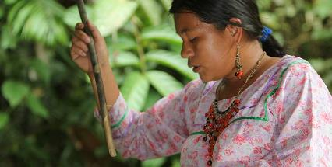
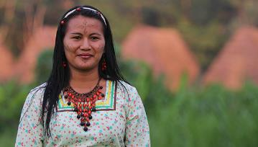
About Kechwa
At present, the basis of their socio-political structure is family. The family unit is the "ayllu" which is the maximum territorial settlement; the union of ayllu make territorial clans. Traditionally the basis of the clans was the offspring from a totemic ancestor, usually an animal sacred as the puma or jaguar and were assigned to a trunk tightly bound relationship relative to its founders shamans; Today, these kinship ties are identified by a last name.
The family has traditionally been the center for socializing, through oral tradition, ie the transmission of customs and traditions of culture from generation to generation. Similarly, through practice transfer the knowledge to their subsistence activities, agricultural techniques, fishing, hunting, working basketry, ceramics, traditional medicine is socialized, etc.
The main economic and traditional subsistence activities are based on shifting cultivation swidden gardens in purines or jungle; hunting, fishing, gathering and exchanging products and handicrafts. Lately they have been incorporated as new livestock activities and ecotourism, which are causing profound changes in both the ecosystem and the content of their culture.

Slide 7
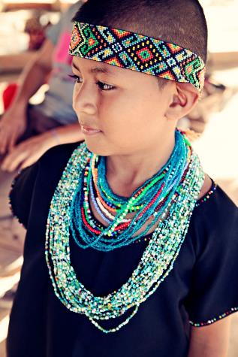
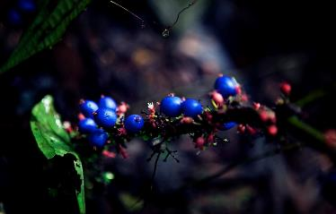
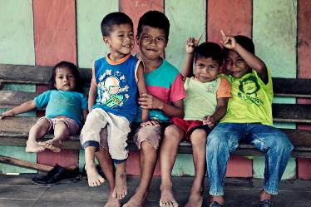
Life Plan and Future Proyects

Slide 8
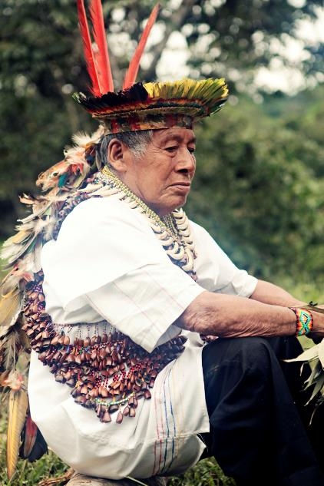
Indigenous Traditional Medicine
• Preservation of the traditional use of Yaje for medicinal and spiritual support of the community.
• Support for the identification and preservation of spiritual areas and sacred sites of Kechwa and Siona peoples of San José de Wisuya.
• Development of a botanical garden for the classification of medicinal plants.
• Strengthening of ancient medicinal gardens and native seeds of kechwa and Siona peoples.
• Construction of a communal Maloka for holding sacred ceremonies .

Slide 9
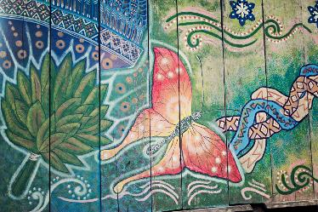
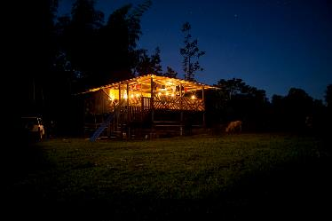
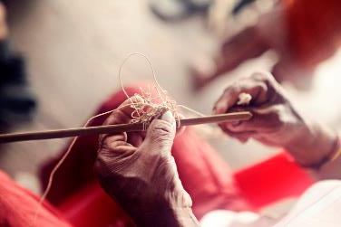
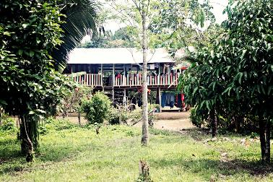
Culture and Tradition
Teach Siona and Kechwa languages.
Promote artistic expression and manufacture of handicrafts for financial support and commerce.
Promote indigenous music and dance.

Slide 10
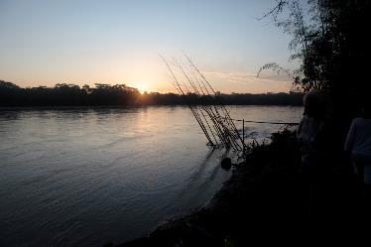
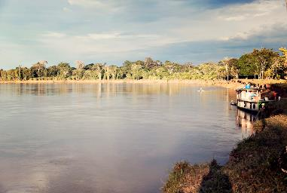
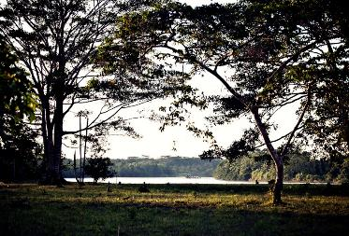
Basic Social Infrastructure
Construction of workshop house.
Construction of health post for the ancestral and traditional medicine.
Buy and land reclamation for the enlarged area of the community.
Construction of Community administrative home.
Construction of pier at the community college

Slide 11
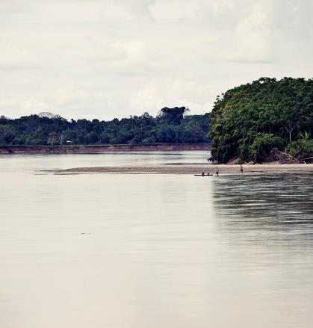
Environment and Ecology
Create ecological trails for animals and birds watching in the wetlands of the community.
Conservation of primary forests within the community.
Sewage treatment in the community.
Recycling and waste management.

Slide 12
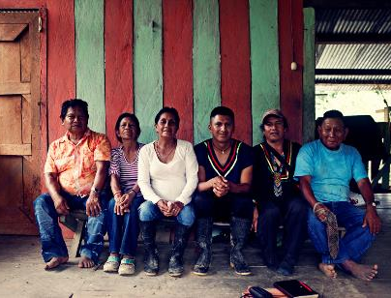
Training and Talent / Indigenous Community Safety
Training workshops for leaders on Governance
Training on human rights, collective rights, treaties, international agreements, arrangements and safety law.

